Slide 1

Computer Architecture
A Quantitative Approach, Sixth Edition
Chapter 4
Data-Level Parallelism in Vector, SIMD, and GPU Architectures

Slide 2
Introduction
Introduction
SIMD architectures can exploit significant data-level parallelism for:
Matrix-oriented scientific computing
Media-oriented image and sound processors
SIMD is more energy efficient than MIMD
Only needs to fetch one instruction per data operation
Makes SIMD attractive for personal mobile devices
SIMD allows programmer to continue to think sequentially

Slide 3
SIMD Parallelism
Introduction
Vector architectures
SIMD extensions
Graphics Processor Units (GPUs)
For x86 processors:
Expect two additional cores per chip per year
SIMD width to double every four years
Potential speedup from SIMD to be twice that from MIMD!

Slide 4
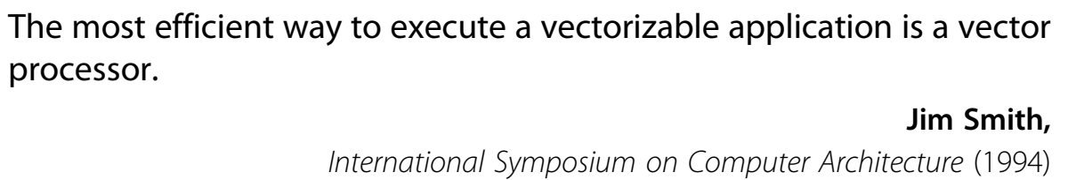
Vector Architectures
Vector Architectures
Basic idea:
Read sets of data elements into “vector registers”
Operate on those registers
Disperse the results back into memory
Registers are controlled by compiler
Used to hide memory latency
Leverage memory bandwidth

Slide 5
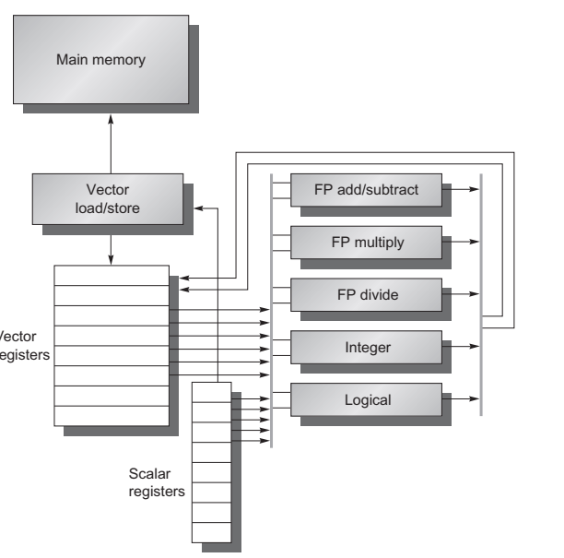
VMIPS
Vector Architectures
Example architecture: RV64V
Loosely based on Cray-1
32 64-bit vector registers
Register file has 16 read ports and 8 write ports
Vector functional units
Fully pipelined
Data and control hazards are detected
Vector load-store unit
Fully pipelined
One word per clock cycle after initial latency
Scalar registers
31 general-purpose registers
32 floating-point registers

Slide 6
VMIPS
Vector Architectures

Slide 7
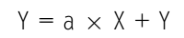
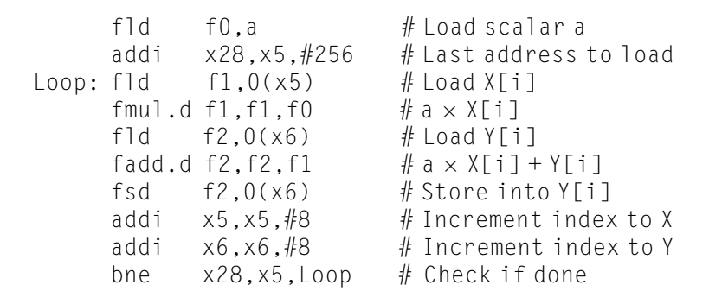
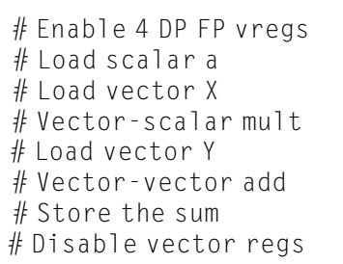
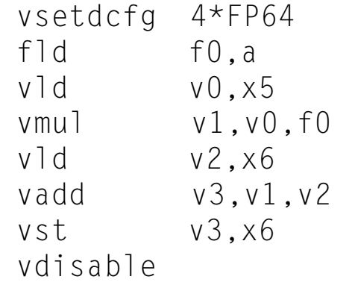
VMIPS Instructions
Vector Architectures
.vv: two vector operands
.vs and .sv: vector and scalar operands
LV/SV: vector load and vector store from address
Example: DAXPY
8 instructions, 258 for RV64V (scalar code)

Slide 8
Vector Execution Time
Vector Architectures
Execution time depends on three factors:
Length of operand vectors
Structural hazards
Data dependencies
RV64V functional units consume one element per clock cycle
Execution time is approximately the vector length
Convoy
Set of vector instructions that could potentially execute together

Slide 9
Chimes
Vector Architectures
Sequences with read-after-write dependency hazards placed in same convey via chaining
Chaining
Allows a vector operation to start as soon as the individual elements of its vector source operand become available
Chime
Unit of time to execute one convey
m convoys executes in m chimes for vector length n
For vector length of n, requires m x n clock cycles

Slide 10
Example
vld v0,x5 # Load vector X
vmul v1,v0,f0 # Vector-scalar multiply
vld v2,x6 # Load vector Y
vadd v3,v1,v2 # Vector-vector add
vst v3,x6 # Store the sum
Convoys:
1 vld vmul
2 vld vadd
3 vst
3 chimes, 2 FP ops per result, cycles per FLOP = 1.5
For 64 element vectors, requires 32 x 3 = 96 clock cycles
Vector Architectures

Slide 11
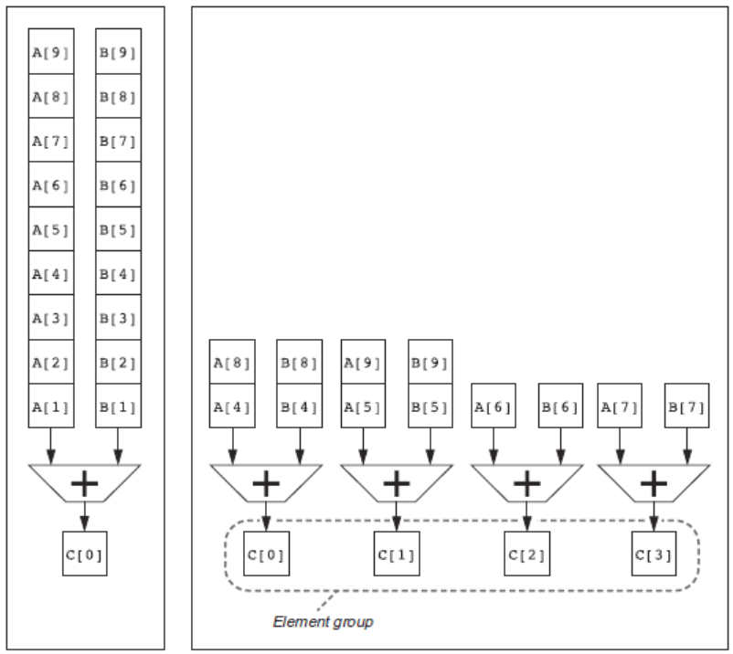
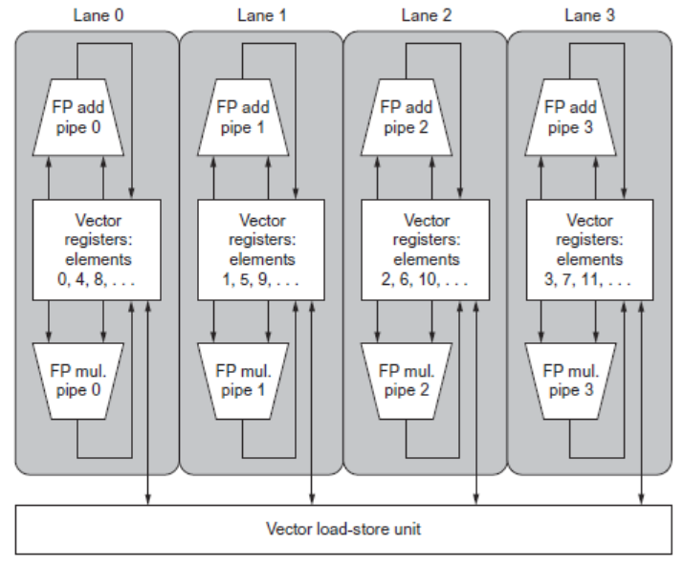
Multiple Lanes
Vector Architectures
Element n of vector register A is “hardwired” to element n of vector register B
Allows for multiple hardware lanes

Slide 12
Vector Length Register
Vector Architectures
for (i=0; i <n; i=i+1) Y[i] = a * X[i] + Y[i];
vsetdcfg 2 DP FP # Enable 2 64b Fl.Pt. registers
fld f0,a # Load scalar a
loop: setvl t0,a0 # vl = t0 = min(mvl,n)
vld v0,x5 # Load vector X
slli t1,t0,3 # t1 = vl * 8 (in bytes)
add x5,x5,t1 # Increment pointer to X by vl*8
vmul v0,v0,f0 # Vector-scalar mult
vld v1,x6 # Load vector Y
vadd v1,v0,v1 # Vector-vector add
sub a0,a0,t0 # n -= vl (t0)
vst v1,x6 # Store the sum into Y
add x6,x6,t1 # Increment pointer to Y by vl*8
bnez a0,loop # Repeat if n != 0
vdisable # Disable vector regs

Slide 13
Vector Mask Registers
Vector Architectures
Consider:
for (i = 0; i < 64; i=i+1)
if (X[i] != 0)
X[i] = X[i] – Y[i];
Use predicate register to “disable” elements:
vsetdcfg 2*FP64 # Enable 2 64b FP vector regs
vsetpcfgi 1 # Enable 1 predicate register
vld v0,x5 # Load vector X into v0
vld v1,x6 # Load vector Y into v1
fmv.d.x f0,x0 # Put (FP) zero into f0
vpne p0,v0,f0 # Set p0(i) to 1 if v0(i)!=f0
vsub v0,v0,v1 # Subtract under vector mask
vst v0,x5 # Store the result in X
vdisable # Disable vector registers
vpdisable # Disable predicate registers

Slide 14
SIMD Extensions
Media applications operate on data types narrower than the native word size
Example: disconnect carry chains to “partition” adder
Limitations, compared to vector instructions:
Number of data operands encoded into op code
No sophisticated addressing modes (strided, scatter-gather)
No mask registers
SIMD Instruction Set Extensions for Multimedia

Slide 15
SIMD Implementations
Implementations:
Intel MMX (1996)
Eight 8-bit integer ops or four 16-bit integer ops
Streaming SIMD Extensions (SSE) (1999)
Eight 16-bit integer ops
Four 32-bit integer/fp ops or two 64-bit integer/fp ops
Advanced Vector Extensions (2010)
Four 64-bit integer/fp ops
AVX-512 (2017)
Eight 64-bit integer/fp ops
Operands must be consecutive and aligned memory locations
SIMD Instruction Set Extensions for Multimedia

